Slide 1

Bank Marketing Campaign
Predicting Term Deposit Subscriptions
Alice Wang
Apr 2023
More details in my github

Slide 2
Problem Statement
How can the financial institution have a greater effectiveness for future marketing campaigns?

Slide 3
Goal
Prediction of the results of the marketing campaign for each customer and clarification of factors which affect the campaign results. This helps to find out the ways how to make marketing campaigns more efficient.
Finding out customer segments, using data for customers, who subscribed to term deposit. This helps to identify the profile of a customer, who is more likely to acquire the product and develop more targeted marketing campaigns.

Slide 4
Dataset
Marketing bank dataset uploaded originally in the UCI Machine Learning Repository
Input variables:
Bank client data:
age, job, marital, education, default, housing, loan, balance
Campaign data:
contact, month, day, duration, campaign, pdays, previous, poutcome
Output variable: Has the client subscribed a term deposit?

Slide 5
Data Wrangling
Major steps:
The dataset has a shape of (11162, 17)
Check for duplicates: There are 0 duplicates for this dataset
Check for missing values: There are 0 missing values
Will perform EDA and see if we need to drop any fields for pre processing

Slide 6
Exploratory Data Analysis

Slide 7
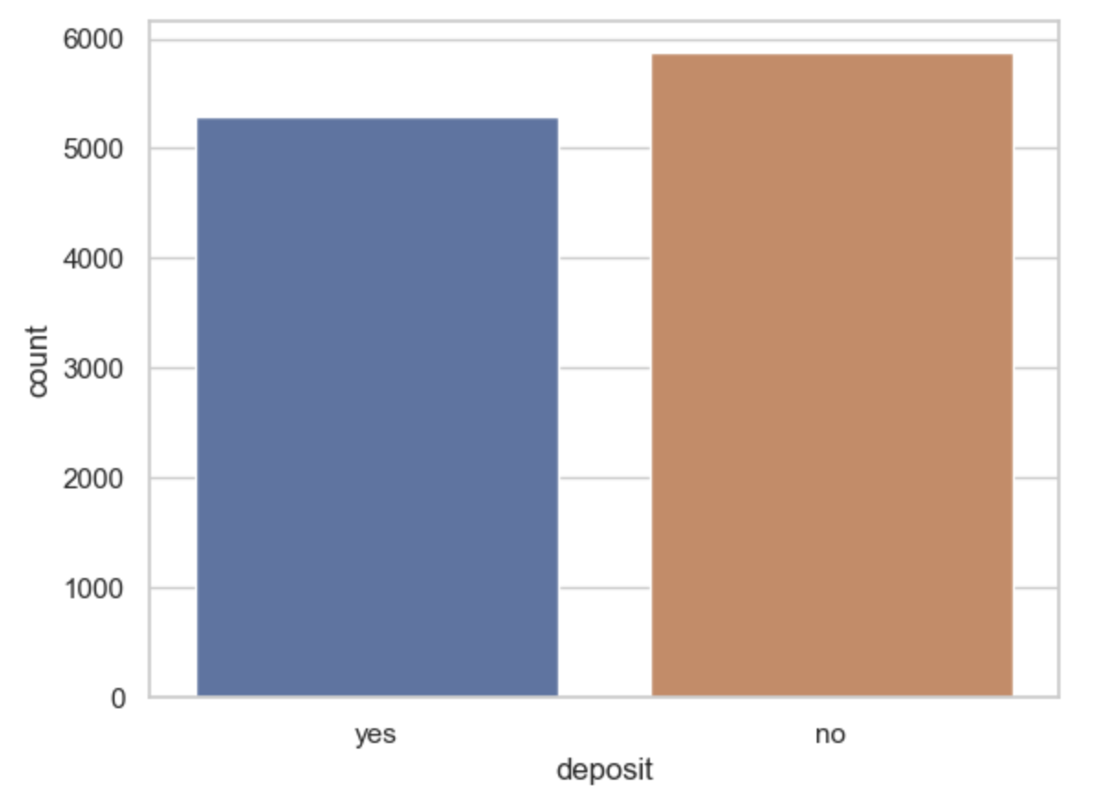
Term Deposit
Target variable 'deposit' is balanced, we can use accuracy as a metric for a model, which predicts the campaign outcome.

Slide 8
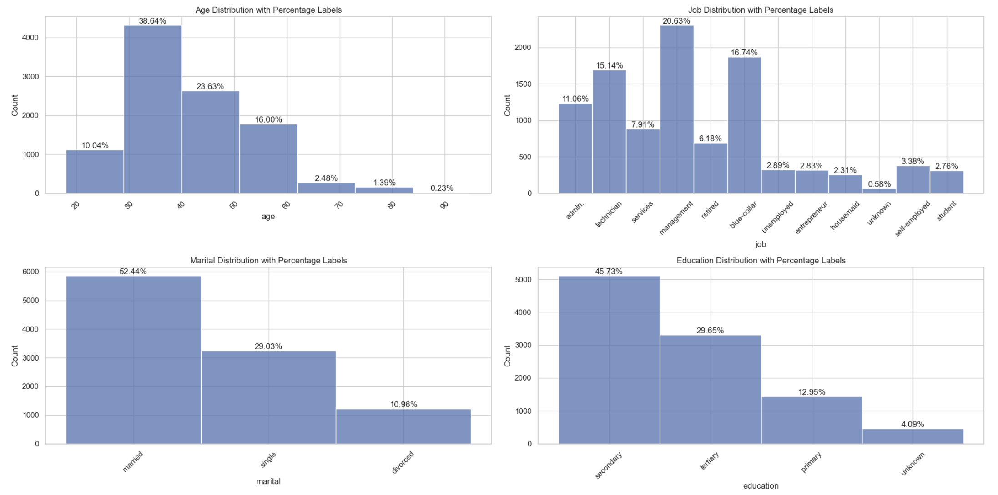
Client Demographic Analysis
36% of clients are in the age 30's-40's
Top 3 job: 20% of clients work in management, followed by 16% in blue-collar, and 15% technician
More than half with 52% are married
45% have a secondary education

Slide 9
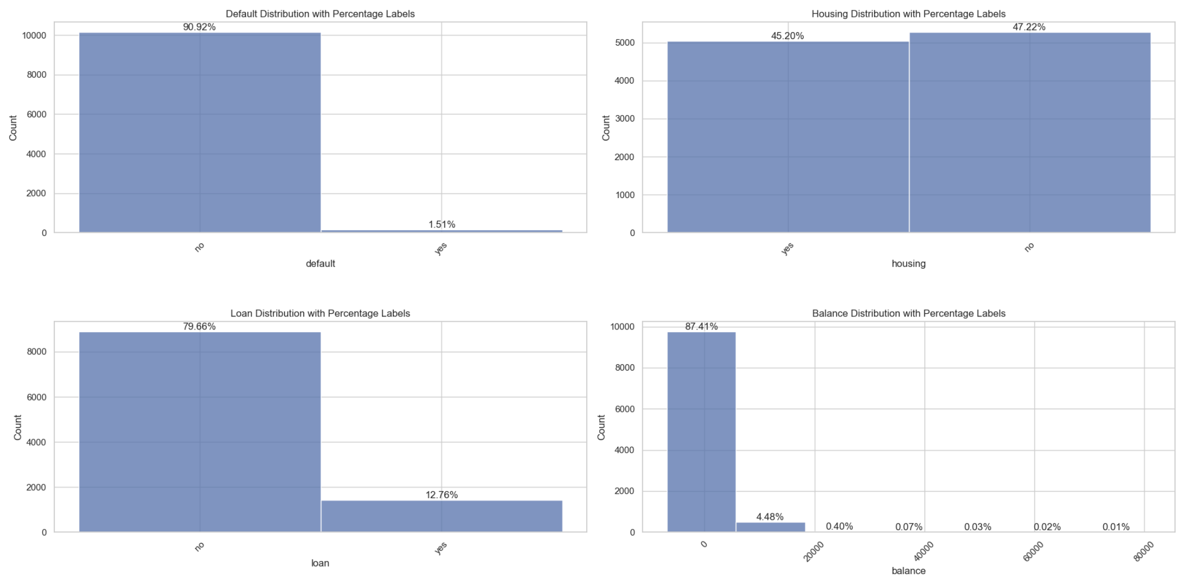
Client Demographic Analysis
Mostly have no loan and no default credit card.
It's 50-50 in terms of having housing
90% of clients have balance below $20,000

Slide 10
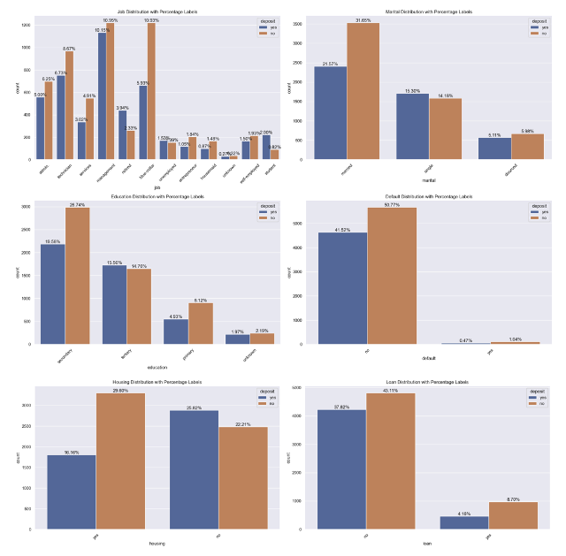
Demographic Distribution vs Target variable with Percentage Labels
In terms of comparing with deposit, client's demographic aligns our previous discovery except that the clients who have a technician job have slightly higher deposit rate than blue-collar.

Slide 11
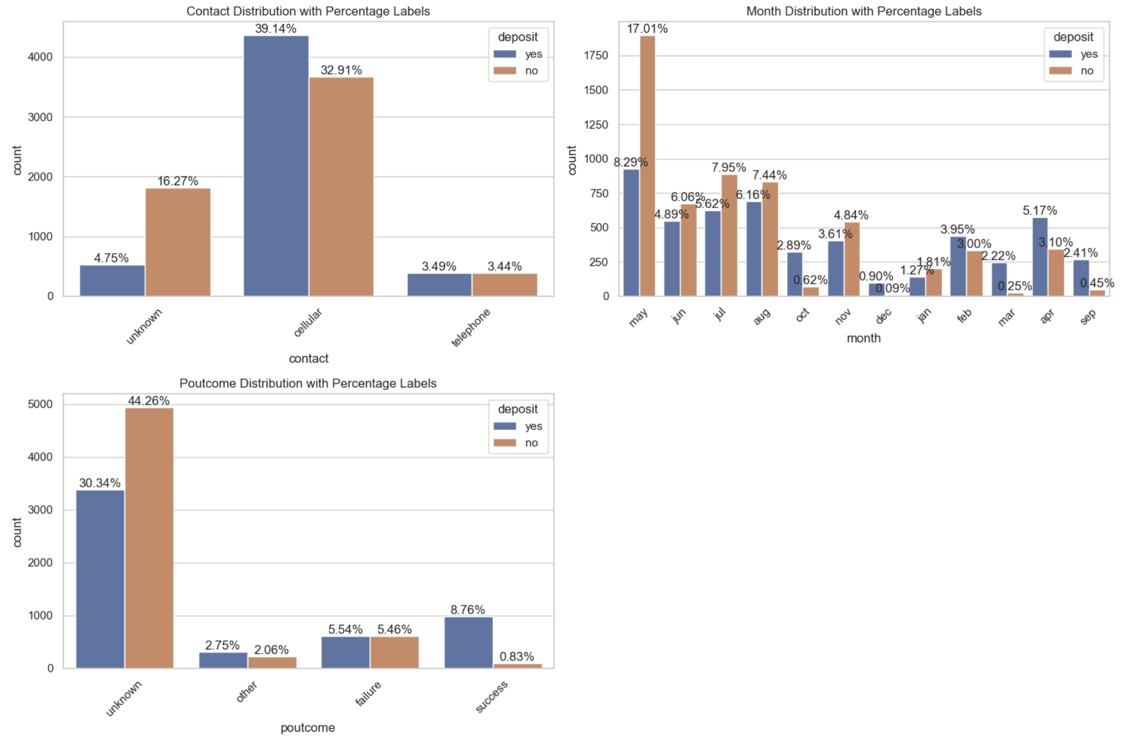
Campaign Distribution vs Target variable with Percentage Labels
Contact by caller have 39% deposit rate
May & August have higher deposit rate
Unknown outcome of the previous marketing campaign has higher depost rate

Slide 12
Hypothesis Testing

Slide 13
Hypothesis Testing: Client Demographic VS Term Deposit
Hypothesis 1: Age vs Term Deposit
Performed Independent two-sample t-test
Conclusion: There is a significant difference in the mean ages between clients who have subscribed to a term deposit and those who have not.
Hypothesis 2: Marital Status vs Term Deposit
Performed Chi-square test
Conclusion: There is a significant relationship between marital status and term deposit subscription.
Hypothesis 3: Balance vs Term Deposit
Performed Independent two-sample t-test
Conclusion: There is a significant difference in the balance of clients who have subscribed to a term deposit vs. those who have not.

Slide 14
Feature Engineering & Modeling

Slide 15
Feature Engineering
Feature Engineering Major Steps:
Encode some categorical features as ordered numbers when there is information in the order
Log transform of the skewed numerical features to lessen impact of outliers
Transformation of categorical features vis one-hot encoding
Convert target variable to Boolean
Split into testing and training datasets
Standardize the magnitude of numeric features using a scaler

Slide 16
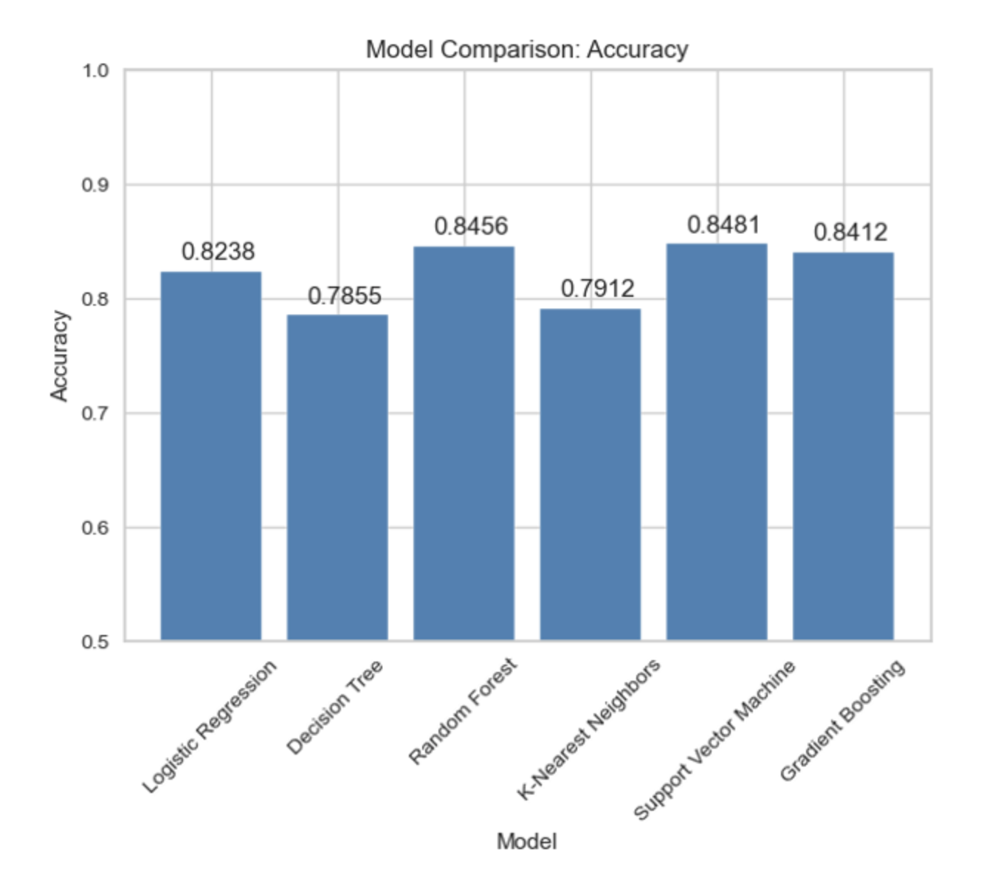
Modeling
Modeling Major Steps:
Logistic Regression
Decision Tree
Random Forest
K-Nearest Neighbors
Support Vector Machine
Gradient Boosting
Model Validation Metric:
Accuracy
Precision
Recall
F1-score
AUC-ROC
Model Optimization:
Model Tuning on random forest using both GridSerchCV and RandomanizedCV did not improve performance, so will use RandomForestClassifier without tuning.

Slide 17
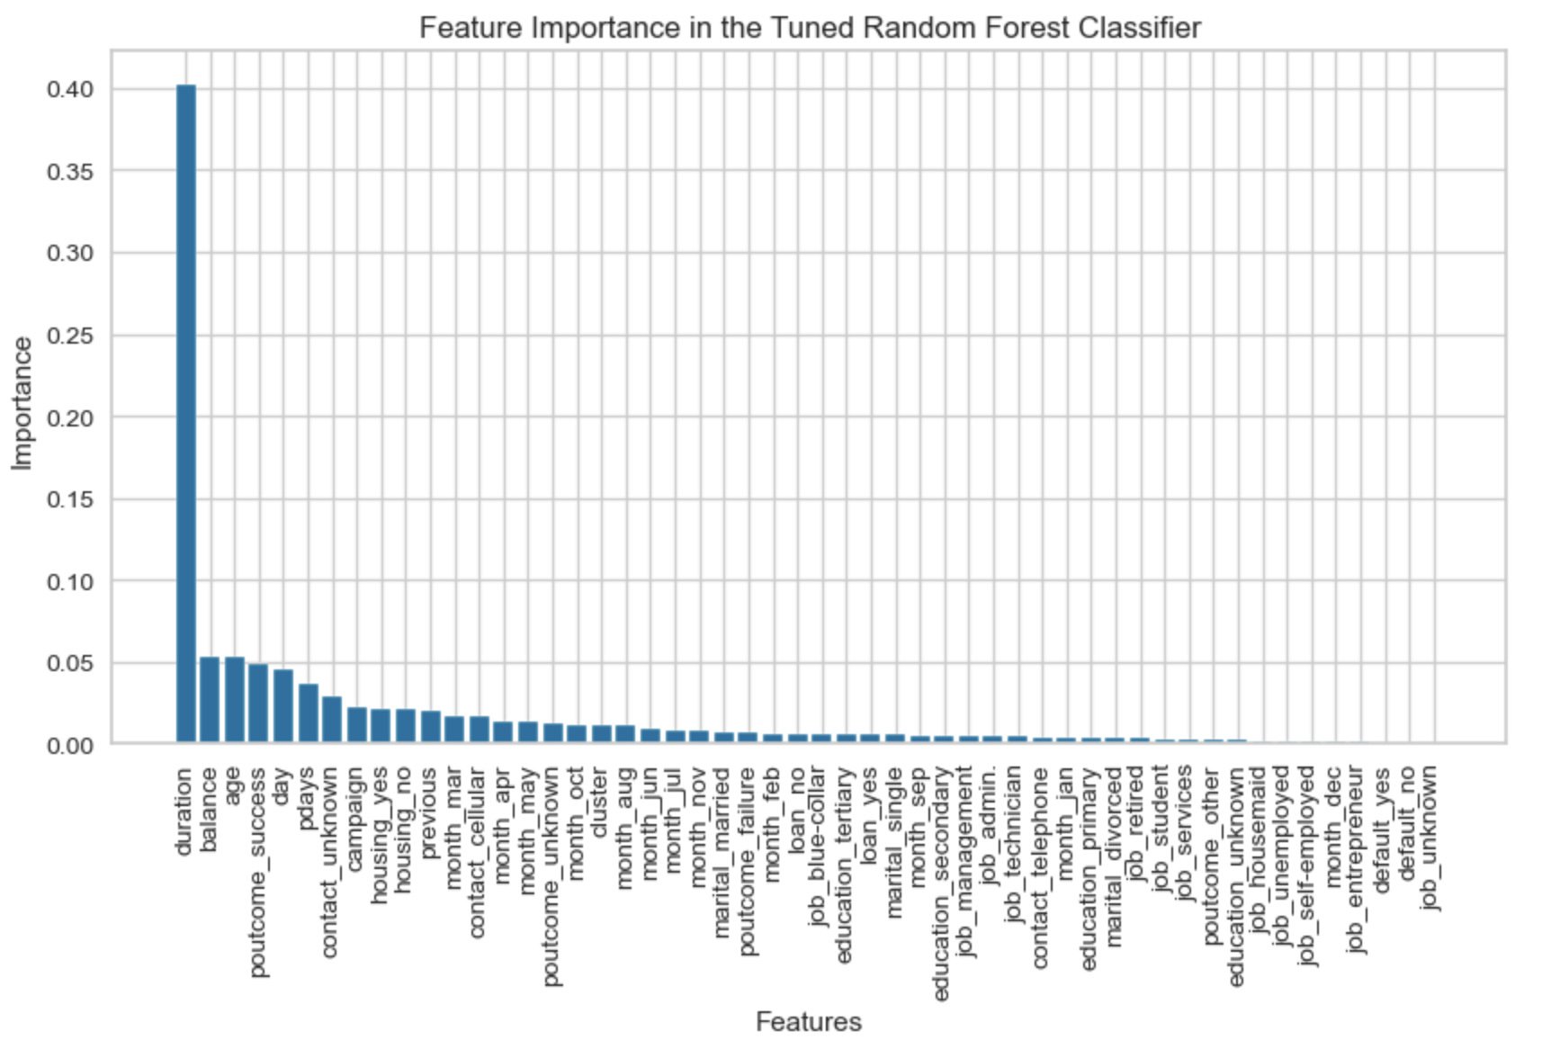
Top Features by RandomForestClassifier
As noted in the beginning that duration attribute highly affects the output target. Yet, the duration is not known before a call is performed. Also, after the end of the call y is obviously known. Thus, this input should only be included for benchmark purposes and should be discarded if the intention is to have a realistic predictive model. We will not focus on duration for modeling.
As we can see from the diagram showing feature importance, the most important features are:
Customer's account balance
Customer's age
Success outcome of the previous marketing campaign

Slide 18
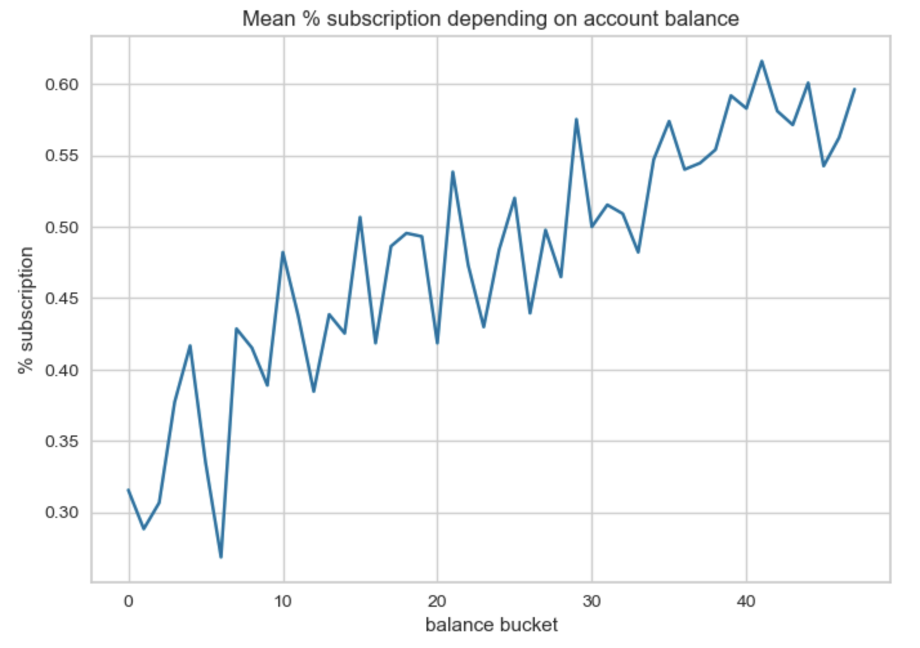
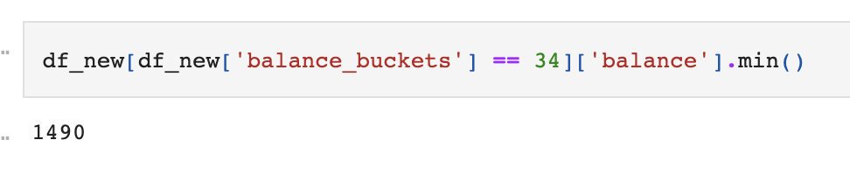
Account Balance For Marketing Campaign
Marketing campaigns should concentrate on customers with account balance greater than $1490.

Slide 19
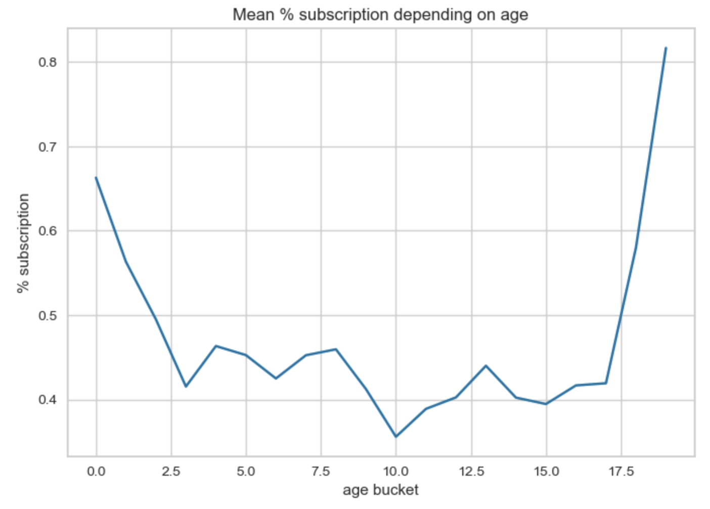
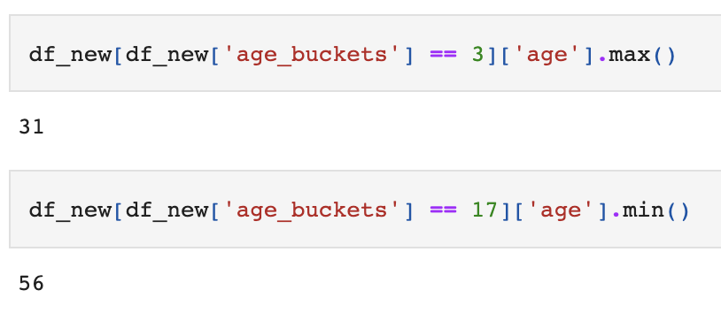
Age Bucket For Marketing Campaign
Marketing campaigns should concentrate on customers with age below 31 years old or above 56 years old.

Slide 20
Recommendations: What Actions should the Bank Consider?
Solutions for the Next Marketing Campaign (Conclusion):
Age Category: The next marketing campaign of the bank should target potential clients from age categories below 30 years old and above 50 years old.
Occupation: Not surprisingly, potential clients that were students or retired were the most likely to subscribe to a term deposit. Retired individuals, tend to have more term deposits in order to gain some cash through interest payments. Remember, term deposits are short-term loans in which the individual (in this case the retired person) agrees not to withdraw the cash from the bank until a certain date agreed between the individual and the financial institution. After that time the individual gets its capital back and its interest made on the loan. Retired individuals tend to not spend bigly its cash so they are more likely to put their cash to work by lending it to the financial institution. Students were the other group that used to subscribe term deposits.
Balance: The customer's account balance has a huge influence on the campaign's outcome. People with account balance above 1490$ are more likely to subscribe for term deposit, so future address those customers.
Seasonality: Potential clients opted to subscribe term deposits during the seasons of fall and winter. The next marketing campaign should focus its activity throughout these seasons.

Slide 21
THANK YOU

